Slide 1
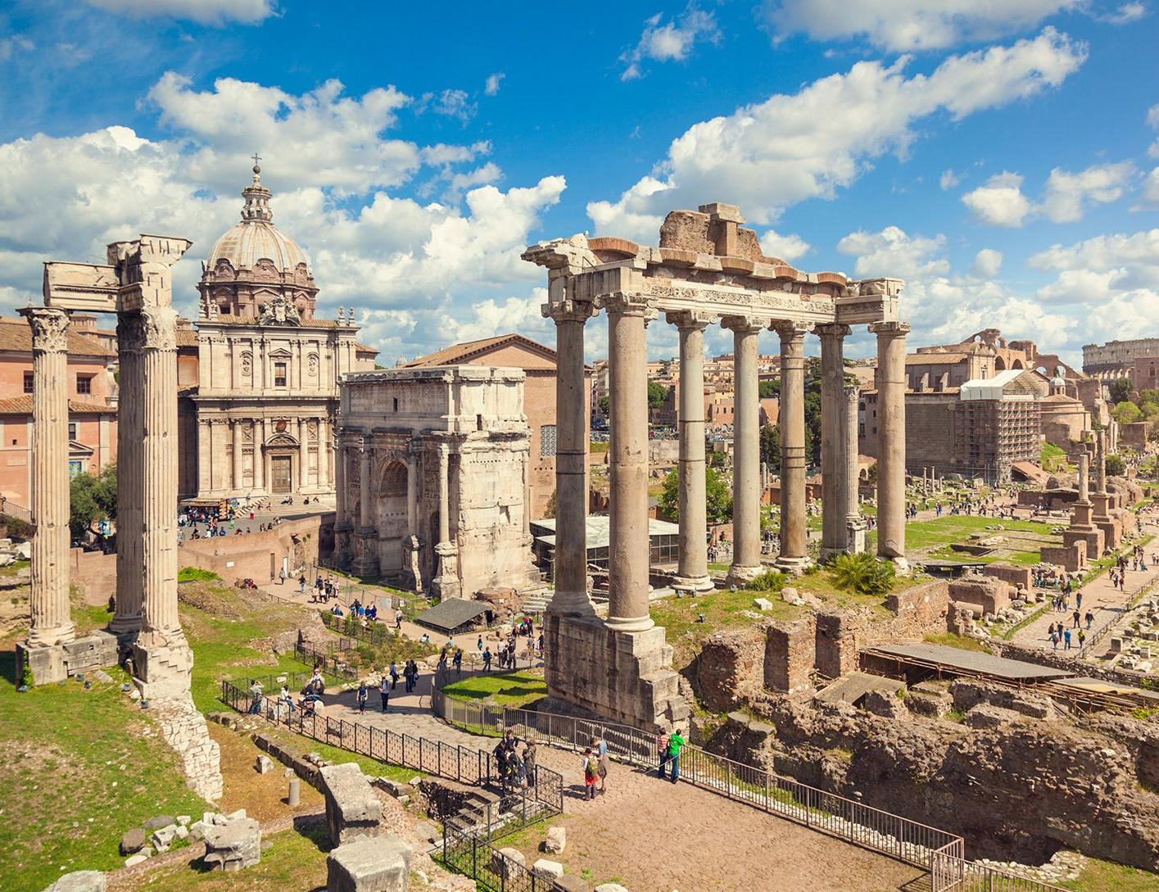
Ancient Roman Artefacts
- Analyse Ancient Roman Artefacts
Week 4 Lesson 4
Ms Barrie

Slide 2
The history of the Roman Empire can be divided into four distinct periods: - The Founding (c. 625 BCE) - The Period of Kings / Regal (625-510 BCE) - Republican Rome (510-31 BCE) - Imperial Rome (31 BCE – 476CE).
Based on the key words, what do you think the features were of each time period?

Slide 3

ACTIVITY – Source Analysis
Worksheet - 1 per/student
Follow instructions on the worksheet – analyse the sources!
You will have 15 minutes to complete Step 1
You will have 30 minutes to complete Step 2

Slide 4
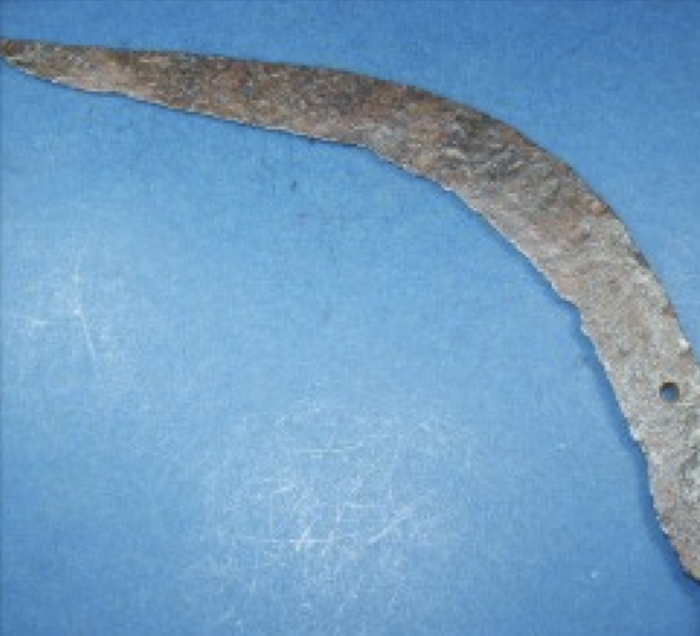
Artefact 1 – Sickle
Farmers in Ancient Rome used tools to plant and harvest their crops. One of these tools was the sickle.
Some of the original sickles were made from a donkey's jaw, but metal soon became the material of choice. During the Roman era, sickles were often made of iron.
The ancient roman sickle was a lightweight curved iron blade affixed to a sturdy wooden handle. They were also designed in such a way that additional serrated blades could also be attached.

Slide 5
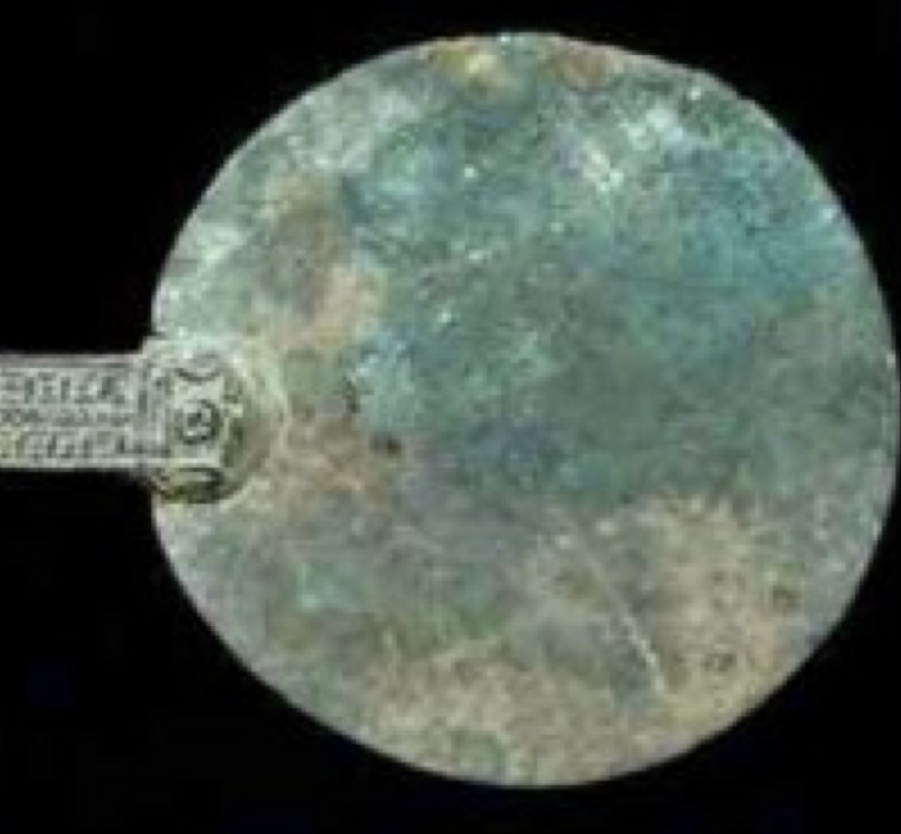
Artefact 2 – Mirror
Mirrors in ancient Rome were quite important because cleanliness and grooming were highly valued in the empire.
Public baths were also very popular in Ancient Rome.
Mirrors helped people maintain cleanliness within the Roman empire and were hung in many public places in ancient Rome.

Slide 6
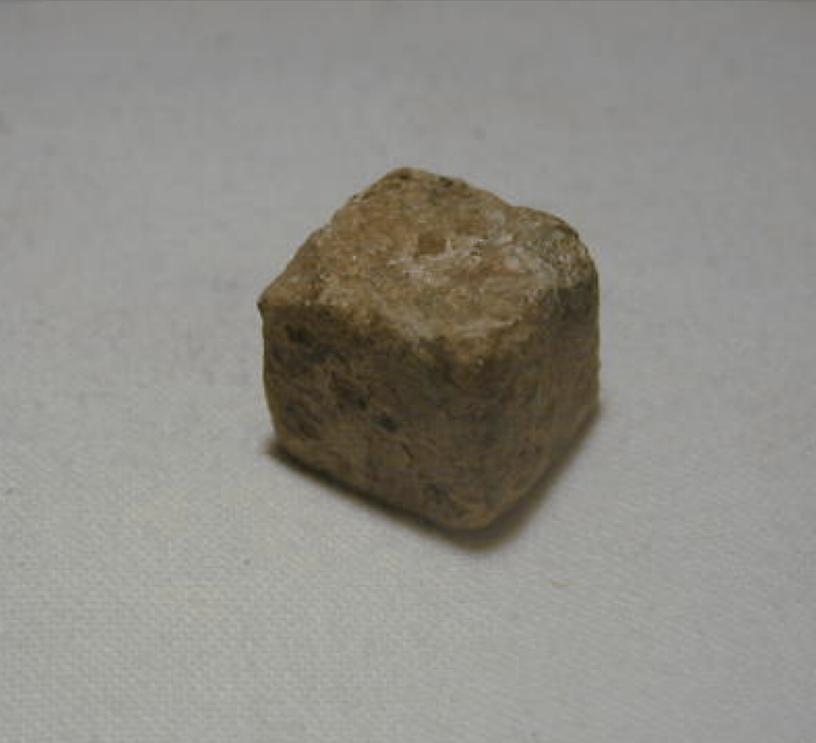
Artefact 3 – Dice
Games were a part of peoples lives, even in Roman times.
Dice have been an integral part of gaming for centuries.
The very word we use for dice is derived from the Latin datum, meaning "something played.
Games provided socialization, fun, and friendly or wagered competition.
Dice are an ancient form of game still in use today.

Slide 7
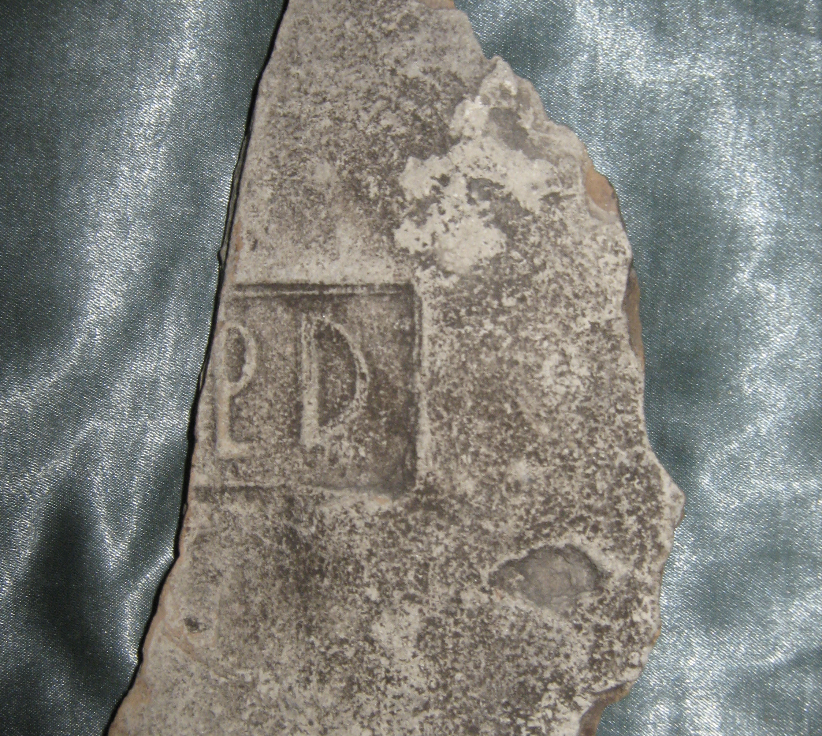
Artefact 4 – Brick
Considering how long some Roman structures have survived, Roman bricks have shown to be durable.
Bricks were made by heating clay into bricks of a variety of sizes. Different sizes were produced in order to accommodate the engineering plans required to build different structures.
Squares, rectangles, triangles, round, and even oblong shapes were employed. The clay would be shaped while it was soft and then heated to solidify the shape.
A stamp of approval was placed on bricks upon completion. This stamp came in the form of the seal of the legion responsible for the oversight of the brick making. This enhanced the quality of the brick construction since the legion would personally attest to its value.

Slide 8
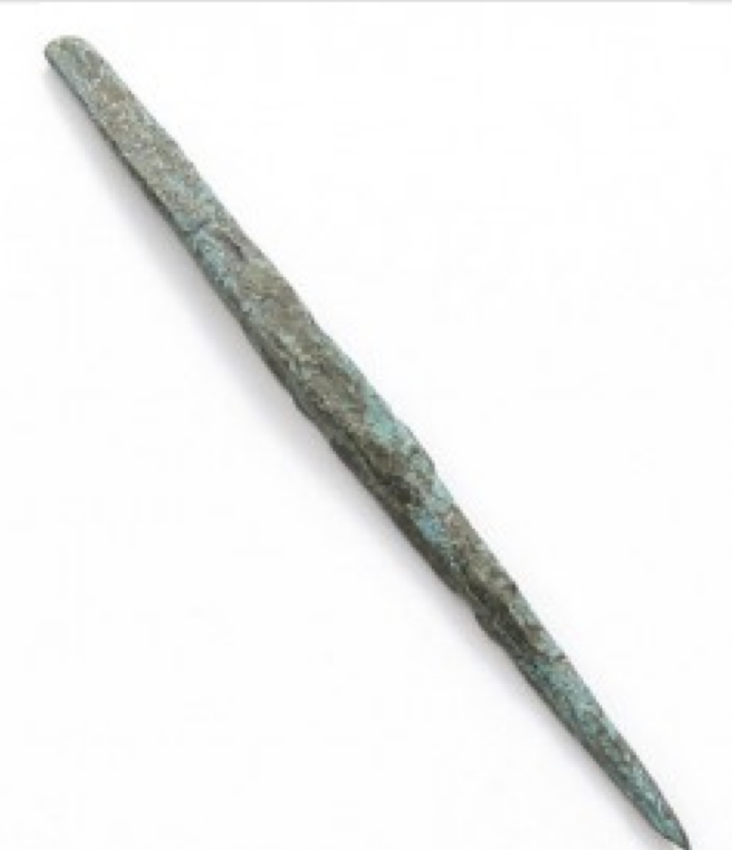
Artefact 5 – Stylus
The Ancient Roman stylus resembles a nail except that it is thicker than standard nails and blunter on the edges.
The Ancient Romans did not have the convenience of pen, so the stylus was pressed on to a tablet made of wax with a wooden border.
They were made out of metals such as bronze, silver, and gold, and some even had intricate designs.
Each stylus had a tipped end to make it easier to grip and were designed like the back of an arrowhead.

Slide 9
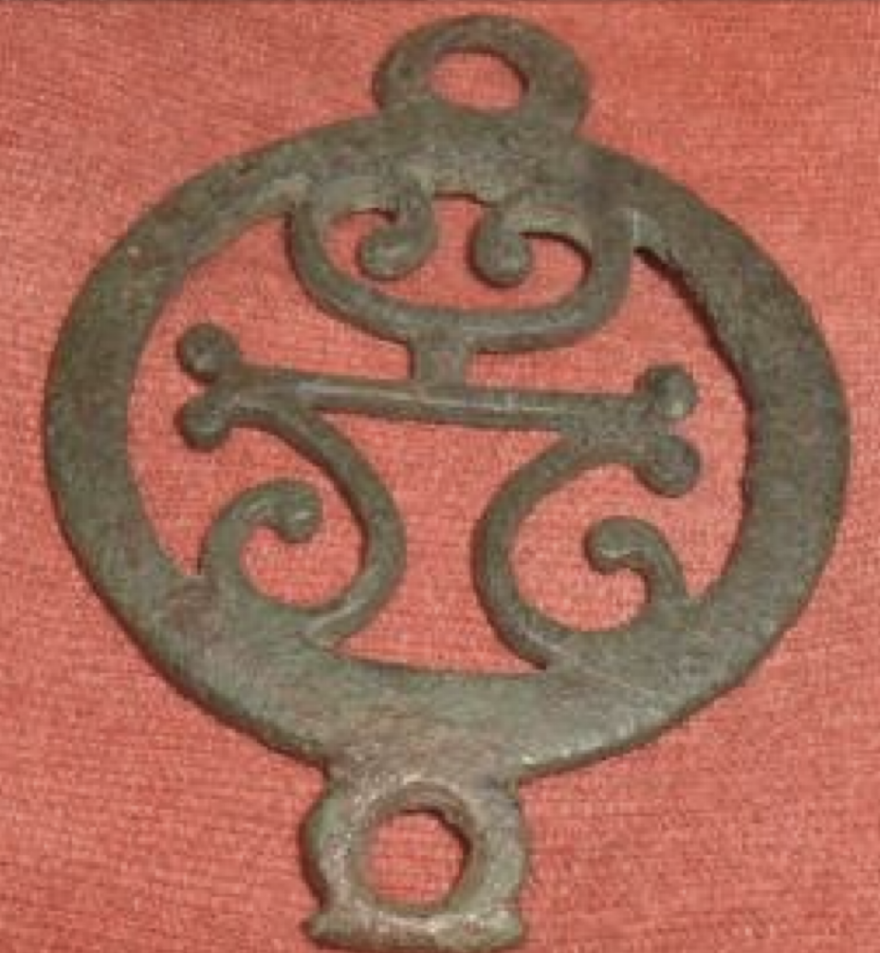
Artefact 6 – Belt Buckle
The Romans knew the value of good accessories to their clothing, belt mount, sometimes known as propellers were attached to the belt for fastening
Military belt mounts were originally worn by soldiers, attached to the belts for fastening purposes. However, it eventually spread to the general public.
Belt mounts were elaborately made in bronze or silver, with ornate decorations. Belt mounts often have studs, decorations, ornamentation, and above all a patina. Sometimes even integrate designs used with herring bone is in the metal.
Some more popular designs for belt mounts were Sunbursts, dolphins, and work done in a circle.

Slide 10
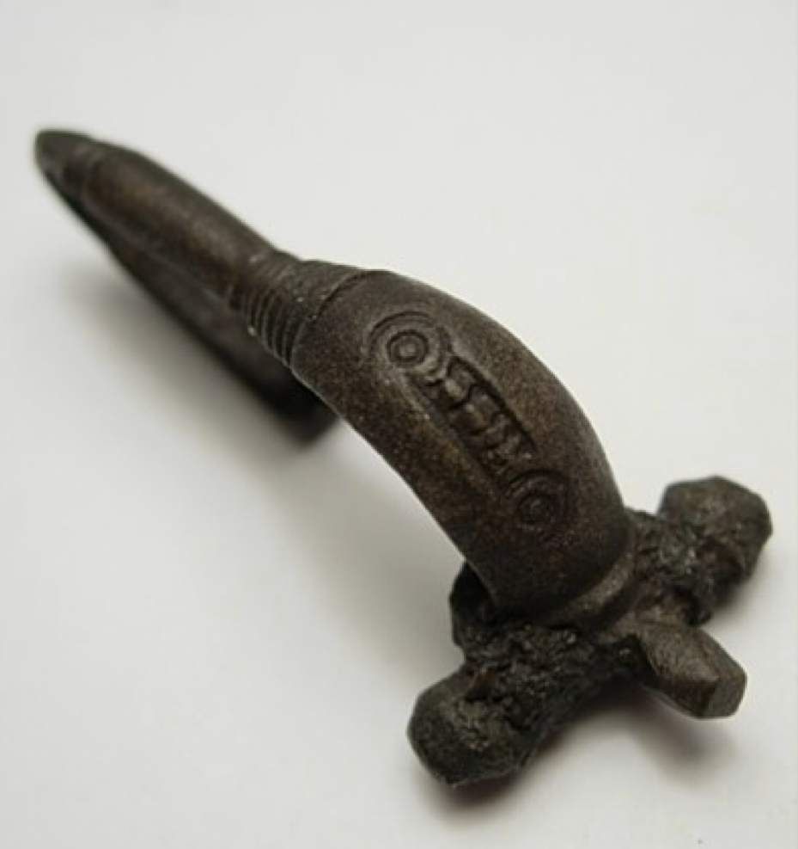
Artefact 7 – Fibulae
A fibulae is the ancient equivalent of a safety pin.
These took the place of straight pins as a clothes fastener, because there was always the chance of the pin falling out.
Not only the Romans, but many other civilizations such as the Egyptians and Greeks used the fibulae to fasten clothes on the shoulder.
Romans of all classes wore fibulae such as gladiators, patricians, plebeians, soldiers, and slaves.

Slide 11
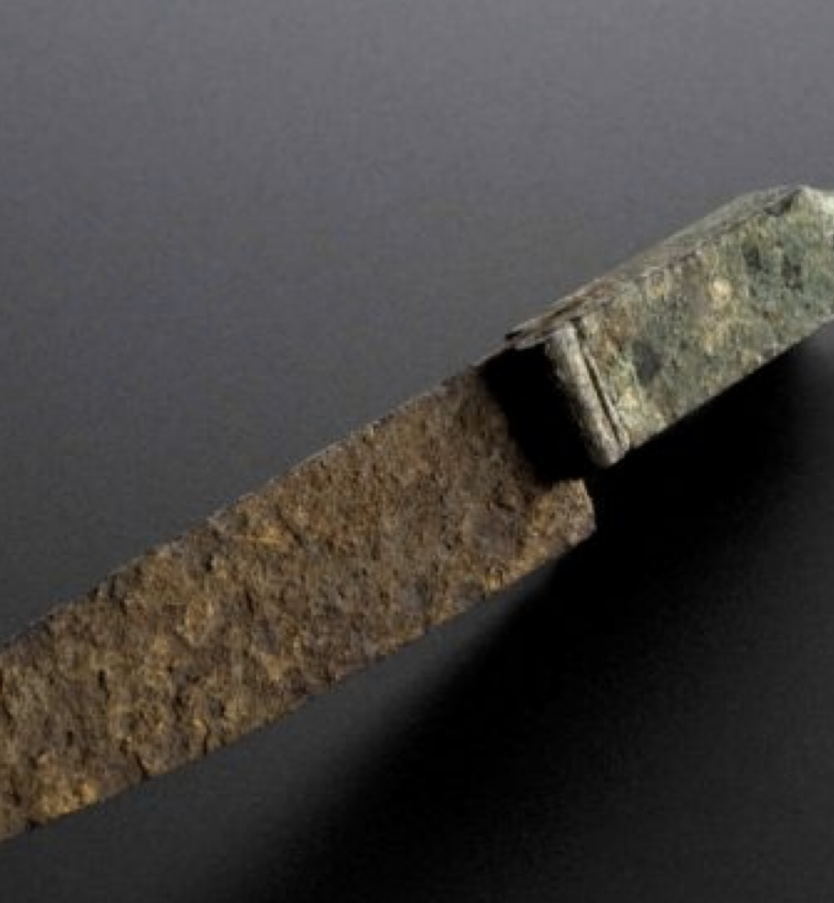
Artefact 8 – Knives
Knives in ancient Rome were used as weapons, medical procedures, or simply cutting bread.
Knives at this times were generally made from bronze or iron, but also sometimes from brass or silver.
Some knives were straight, folding, or on swivelling handles.
There were even some that resembled the modern day Swiss Army knife and included a fork, spoon, spatula, tooth pick, retractable spike and a blade.

Slide 12
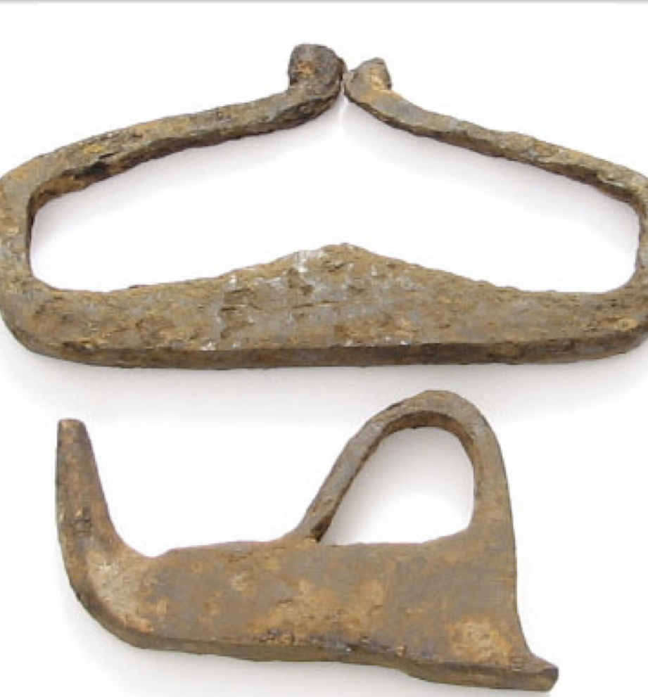
Artefact 9 – Fire Starters
Thriving societies had to have a reliable method of starting fire for cooking and heat.
Starting a fire is hard work yet so essential to modern society that tools were created to assist with making fire.
Firestarters were so handy in Ancient Rome that most households and military battalions had them.
Everyone needed fire on a daily basis. It was the utility tool of the day.
Notes:
firestarters like these were struck against certain types of stone to create sparks for lighting small piles of tinder. They were made of high-carbon iron and forged to be very hard such that they were also effective in sharpening iron arrowheads and spearheads.

Slide 13
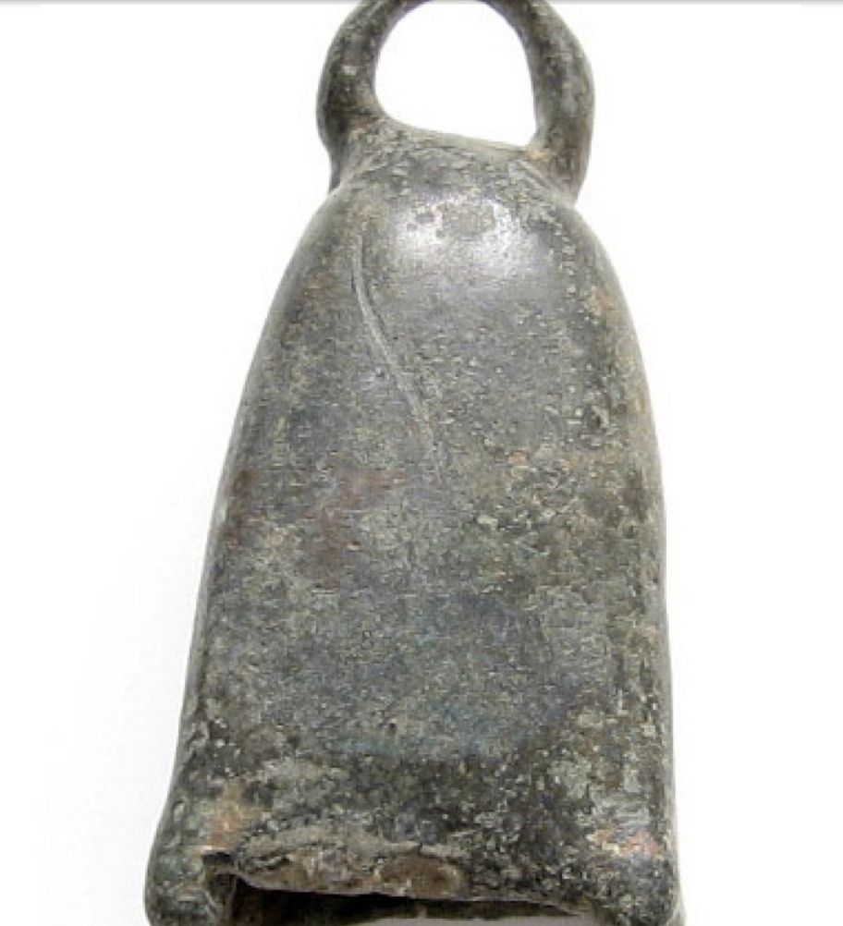
Artefact 10 – Bell
Bells are percussion instruments with an inverted cup shape and something to make the cup vibrate to make a resonant sound, either a clapper, a ball enclosed within, or a mallet used to strike.
In ancient Rome many bells were made of bronze or iron, though some have been ceramic or glass.
The uses of bells varied. A couple of popular uses were for musical rhythm and tempo and bell towers. It may have possibly have been used for military application as well since percussion instruments are ideal for building up the emotional charge that fuels such celebrations.

Slide 14
Questions
What do these artefacts tell you about daily life in Ancient Rome?
Which of these was the most surprising? Why?
Which source taught you the most about Ancient Rome? Why?

